Slide 1
USING EXCEL FOR DATA ANALYSIS - Basic Excel (II) -
Formulas and Functions

Slide 2
Learn to use functions and formulas.
Understanding the anatomy of Excel Formulas, and what their components mean.
Learn basic math functions
Learn basic statistical functions
How to install an Add-in
How to use the Statistics Add-in
Learn to use SUMIF / COUNTIF and SUMIFS / COUNTIFS to add cells only when certain conditions are met.
Learn to use MAXIFS, MINIFS, AVERAGEIF/AVERAGEIFS
Nesting Excel functions
Learn to build standalone logical IF functions and make them more complex by nesting AND and OR within them.
Learn to use the SUBTOTAL function
How to use STOCKHISTORY function to obtain stock data
Text functions - learn to break apart text with the LEFT, RIGHT, MID, FIND and LEN functions.
New text functions TEXTBEFORE and TEXTAFTER
Learn to use VLOOKUP/HLOOKUP/XLOOKUP to find an approximate/exact match and return it or the corresponding value from another column.
Time/Date related functions
Unique Registers
Learn to work with formula auditing tools including tracing precedent and dependent cells.

Slide 3


Basic Excel (II) - 1
Simple Operations
Learn to use functions and formulas.
Understanding the anatomy of Excel Formulas, and what their components mean.
https://www.youtube.com/watch?v=Jl0Qk63z2ZY

Slide 4
Basic Excel (II) – 2
Simple Operations
Learn to use functions and formulas.
Learn basic math functions including:
Sum
Subtract
Multiply
Divide
Count
https://www.youtube.com/watch?v=Jl0Qk63z2ZY

Slide 5

Basic Excel (II) - 3
Penguins
Learn to use functions and formulas.
Learn basic statistical functions including:
AVERAGE
MAX
MIN
MEDIAN
MODE
STDEV.S
QUARTILE.INC
PERCENTILE.INC
Please download the penguins Excel file from Canvas
https://www.youtube.com/watch?v=Jl0Qk63z2ZY

Slide 6
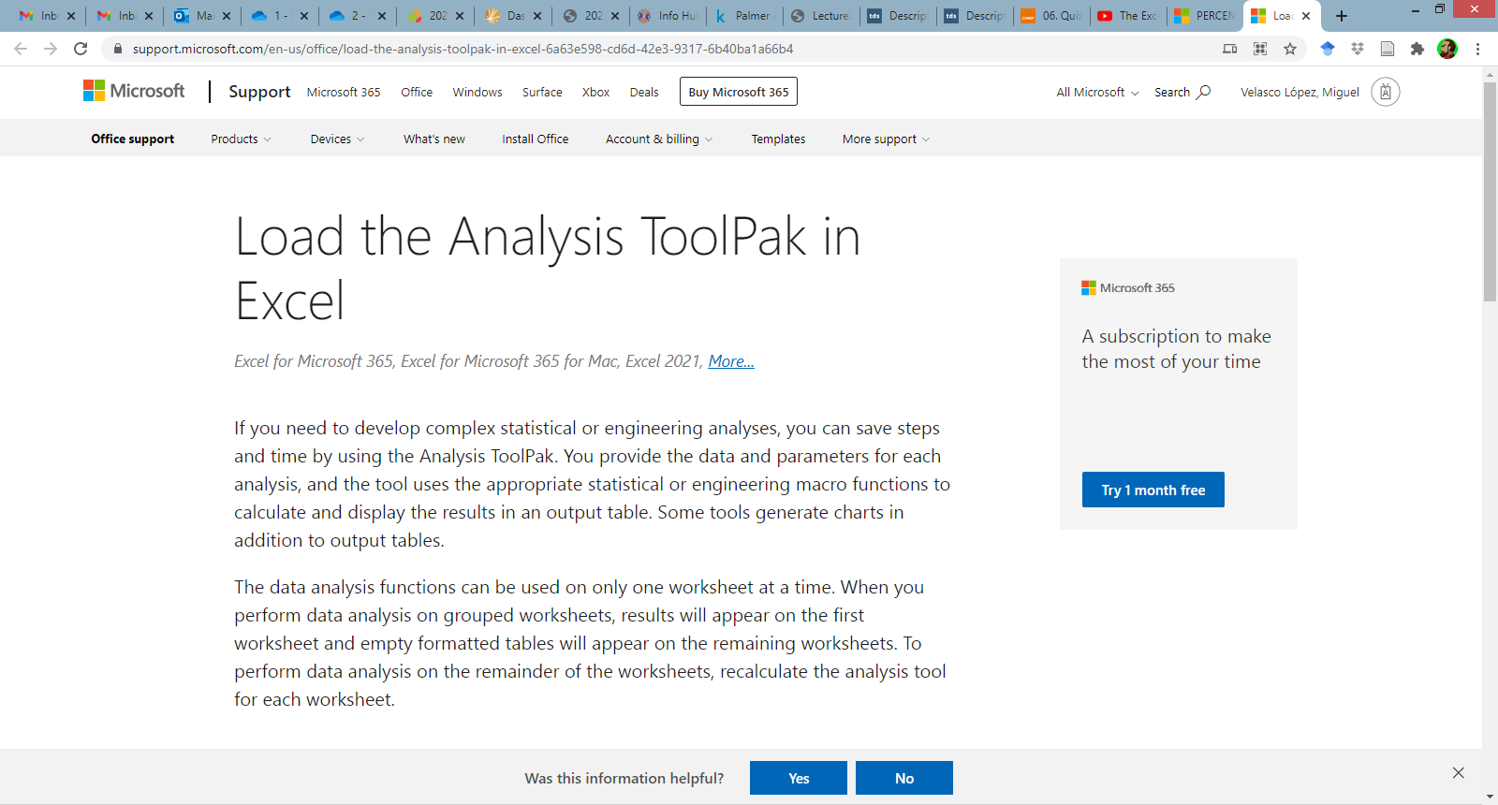
Basic Excel (II) – 4
Penguins 2
How to install an Add-in -> Data Analysis
Instructions
https://www.youtube.com/watch?v=UZdEWo_a4Wc

Slide 7
Basic Excel (II) – 5
Penguins 2
Descriptive Statistics using the Data Analysis add-in
https://www.youtube.com/watch?v=UZdEWo_a4Wc

Slide 8
Basic Excel (II) - 6
Penguins 2
Learn to use functions and formulas.
Learn to use SUMIF / COUNTIF and SUMIFS / COUNTIFS to add cells only when certain conditions are met.
https://www.youtube.com/watch?v=BO1-prCG8DI

Slide 9
Basic Excel (II) - 7
Penguins 2
Learn to use functions and formulas.
Learn to use MAXIFS, MINIFS, AVERAGEIF/AVERAGEIFS
https://www.youtube.com/watch?v=EgluXBBtwZ0
https://www.youtube.com/watch?v=XZwvyyg6J3M

Slide 10
Basic Excel (II) - 8
Logical Functions
Learn to use functions and formulas.
Nesting Excel functions
Comment on customized lists
https://support.microsoft.com/es-es/office/crear-una-lista-desplegable-7693307a-59ef-400a-b769-c5402dce407b
https://www.youtube.com/watch?v=Ytc0WZPpA6E

Slide 11
Basic Excel (II) - 9
Logical Functions
Learn to use functions and formulas.
Learn to build standalone logical IF/IFS functions
make them more complex by nesting AND and OR within them.
https://www.youtube.com/watch?v=H3jOF17Klz4
https://www.youtube.com/watch?v=KkTaQ5OjAGc

Slide 12
Basic Excel (II) - 10
Penguins Subtotal Tables
Learn to use functions and formulas.
Learn to use the SUBTOTAL function
Use with Table Filters
Use with Slicers
https://www.youtube.com/watch?v=0bdhy0ty7Mc

Slide 13
Basic Excel (II) - 11
Stock Quotes
Learn to use functions and formulas.
How to use STOCKHISTORY function to obtain stock data.
https://www.youtube.com/watch?v=dQ9wMNvjfCA

Slide 14
Basic Excel (II) - 12
Text Functions
Learn to use functions and formulas.
Learn to break apart text with the LEFT, RIGHT, MID, FIND and LEN functions.
https://www.youtube.com/watch?v=rbUYH5n0DuM

Slide 15
New Text Features
Text Functions
Textafter and Textbefore
Repeat the previous exercise with these features
https://www.youtube.com/watch?v=p92Ta3J5vGU

Slide 16
Basic Excel (II) - 13
Xlookup
Learn to use functions and formulas.
Learn to use XLOOKUP to find an approximate/exact match and return it or the corresponding value from another column. (VLOOKUP/HLOOKUP/ are discontinued)
https://www.youtube.com/watch?v=4c0CLUER6nw

Slide 17
Basic Excel (II) – 14
Dates
Time-related formulas
Now
Today
Month
Year
Day
Days
Weekday
Yearfrac
https://www.youtube.com/watch?v=vXj0J5MgPTs

Slide 18
Basic Excel (II) - 15
Uniques
Unique Registers UNIQUE()
https://www.youtube.com/watch?v=oW-lpQW1MpQ

Slide 19
Basic Excel (II) - 16
Dates
Learn to use functions and formulas.
Learn to work with formula auditing tools including tracing precedent and dependent cells.
https://www.youtube.com/watch?v=TgT2jeP-TFw

